Slide 1

MINOR PROJECT
Analysis of Cyber Security and Prevention of Data Breaches using Machine learning
PRESENTED BY:
PRIYAL SHARMA 9919102016 (E1)
ISHA SINGH 9919102007 (E1)
VYOM CHAUHAN 9919102011 (E1)
GUIDE:DR.JITENDRA MOHAN

Slide 2
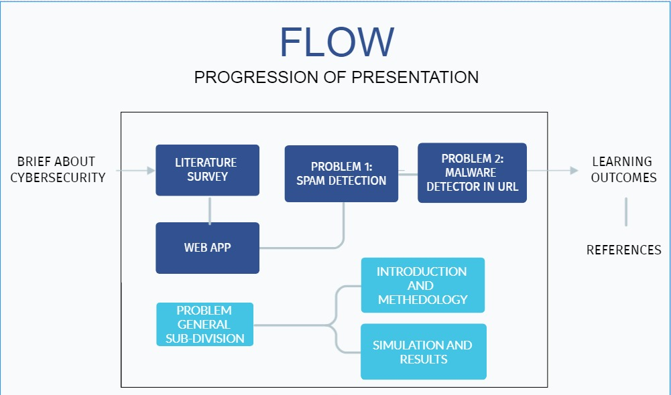

Slide 3
Contents
Our presentation covers the following topics :
Introduction
Web App
Problem 1 Spam detection
Problem 2: Malware in URL

Slide 4
BRIEF ABOUT CYBER SECURITY
With cyber threats constantly evolving, cybersecurity can be a complex undertaking. Cyber-attacks can cause significant disruption and damage to the affected companies causing them to lose their assets, reputation and business and face fines and remediation costs. Therefore, Cybersecurity is created as a solution. An analysis of data breaches from the past years helps us in identifying patterns with the methods used for cyber-attacks and the organization types that mostly come under attack using the aforementioned methods.

Slide 5
RESEARCH PAPER 1:
LITERATURE SURVEY
Peter Sugimura et al. [1] focus on reproducibility of a machine learning model in a web environment.
It tackles the various problems that can be encountered with respect to the different layers of the model

Slide 6
LITERATURE SURVEY
RESEARCH PAPER 2:
Shrawan Kumar Trivedi [2] focuses on evaluating the classification algorithms that can be deployed for discriminating emails into the categories of spam and non-spam.
The dataset used is the Enron Email Corpus
The algorithms are compared on the performance metrics of F-rate(Precision and Recall), False Positive Rate and Training time.

Slide 7
LITERATURE SURVEY
RESEARCH PAPER 3:
Michael Crawford et al. [3] in their paper detects the existence of spam when it comes to e-commerce reviews.
It examines several datasets such as Amazon product reviews, Yelp reservation services among others.
The paper focuses on finding a suitable pre processing method using Natural Languages Processing followed by an efficient classification algorithm on the basis of Accuracy and F-score.

Slide 8
LITERATURE SURVEY
RESEARCH PAPER 4:
Tishenko Viktor Nikolaevich et Al [4] have facilitated a malware detection system for URL with high degree of accuracy
The experimental dataset for malicious URL detection model includes: 470.000 URLs , of which about 70.000 URLs are malicious and 400.000 URLs are safe.
The Model had an accuracy of 93.39% using Support Vector Machine and 99.77% using Random Forest

Slide 9
LITERATURE SURVEY
RESEARCH PAPER 5:
N.Vanitha et Al [5]evaluated logistic regression as the driver algorithm for malware detection in URL
The model is trained for multiple times with different data split ratio such as 1:1, 1:4, 10:1 and compared with previous models and the learning accuracy score is compared.
The dataset is obtained from phish tank
The model presented in this work achieves the said accuracy of 98.42% using logistic regression at lower time complexity

Slide 10
WEB APP
This project is implemented using Python and Jupyter Notebook. The interface of this project is done using Python’s web hosting library called Flask.
Web App is a compilation of the output of the models developed using Flask. HTML, CSS, and bootstrap.
The main motive to create such a project is to help organizations and individuals combat the ever-evolving threat of Data breaches and one of the most essential components aiding it which is Hacking.

Slide 11

Home Page: The representation of homepage of the interactive web portal is shown in fig.1 which directs to the Homepage, About, Contributors, Analytics, Services Blogs sections respectively and also to the sign up form.
fig. 1 Homepage of WebApp

Slide 12
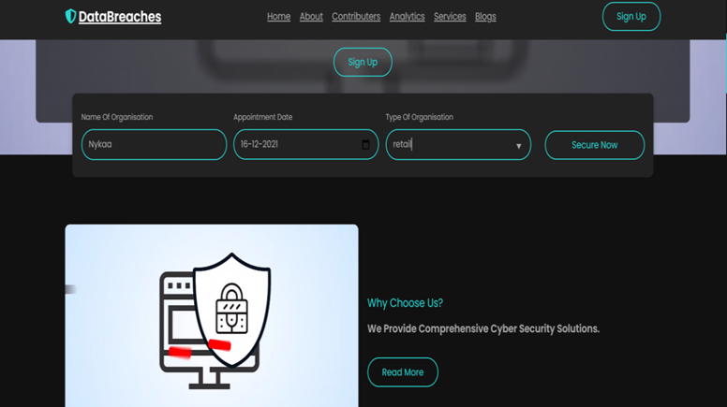
About WebApp: fig. 2 is the representation of the sign-up form through which the user can fill in their details about name, book an appointment date and their organization category and can get the security suggestions based on organization type once signing up.
fig. 2 Signup Form from our WebApp

Slide 13
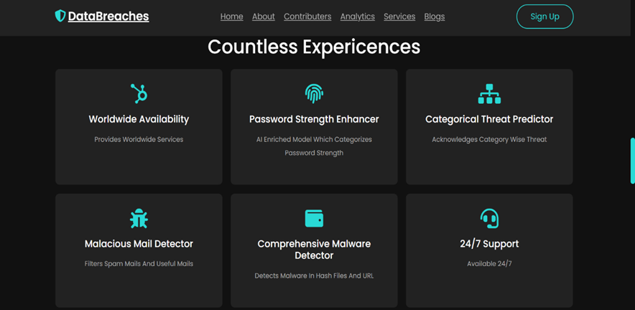
Services of WebApp: The services provided by our model i.e., password strength detector, categorical threat predictor, spam detector and malicious file detector is represented in fig. 3
fig. 3 Services provided by our WebApp

Slide 14
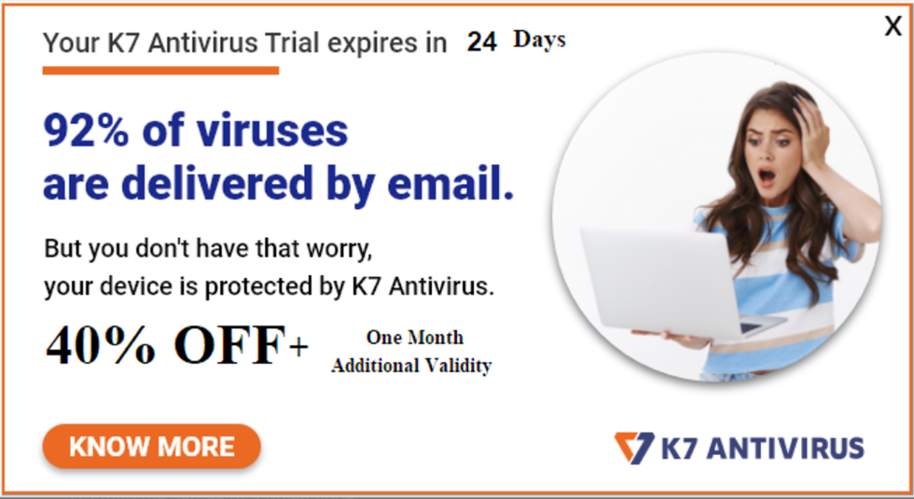
PROBLEM 1: Why is Spam Detection Important ?
•Email Spam also referred to as junk email or simply spam, is unsolicited messages sent in bulk by email to an indiscriminate recipient list.
•Spam messages often come from illegitimate email addresses, and may contain explicit or illegal content.
•An email system without spam filtering is highly vulnerable, if not unusable. It is important to stop as much spam as we can, to protect our network from the many possible risks: viruses, phishing attacks, compromised web links and other malicious content.
Source: https://www.passwordmonster.com/

Slide 15
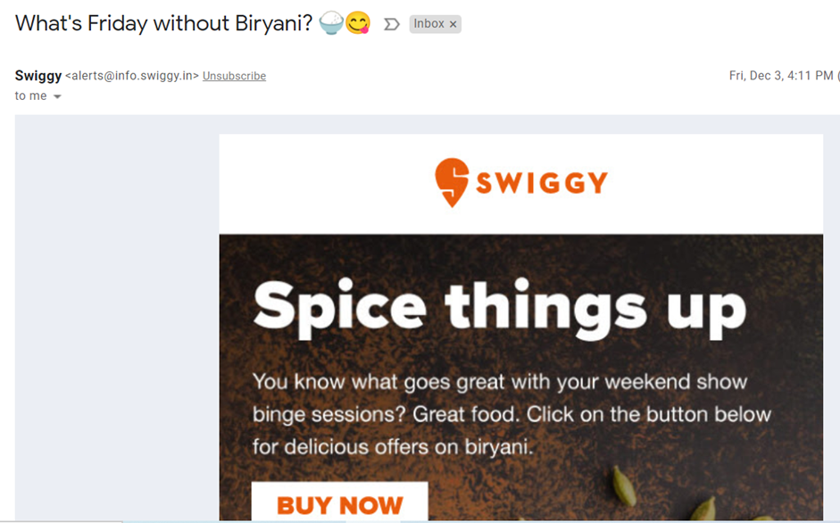
Machine Learning and Spam Detection
They seldom contain an unsubscribe link, and if it does, that link may be embedded with malware.
Traditional static rules involve checking BCC recipients, very short body text, and all caps subjects as well as dubious sender domains and email addresses.
Machine Learning uses statistical models which help us in deciphering spam not just from their characteristic features but from their content.
It is also useful when it comes to detecting grey non spam emails.
Non Spam Email to show the presence of Unsubscribe button that differentiates legitimate emails from spam.
Source: Personal Email Inbox

Slide 16


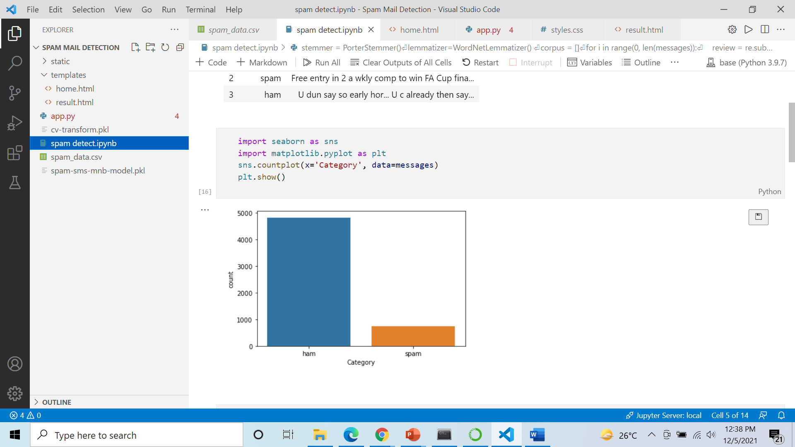
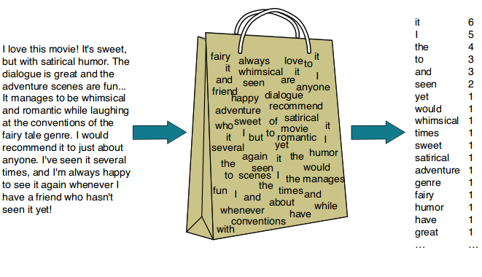
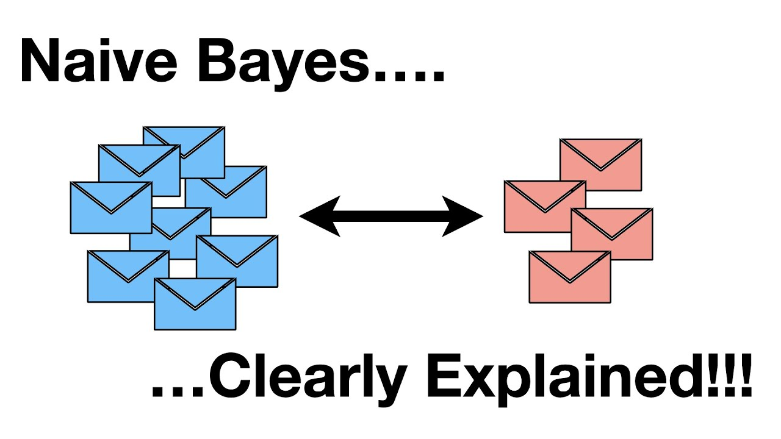
Spam Filtering Architecture
Classification
Algorithms
Word Stemming and Lemmatizing
Bag of Words Model using CountVectorizer
Filtered Spam Output
Distribution of Spam and Non Spam emails in the dataset. Source: Our colab file
Bag of Words Model Source: https://machinelearningmastery.com/gentle-introduction-bag-words-model/

Slide 17
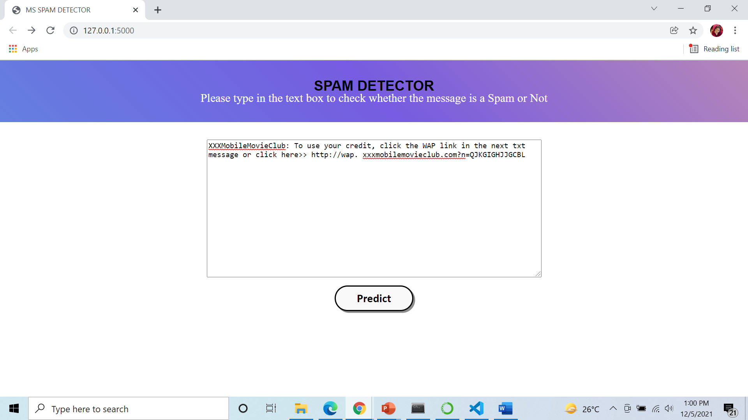
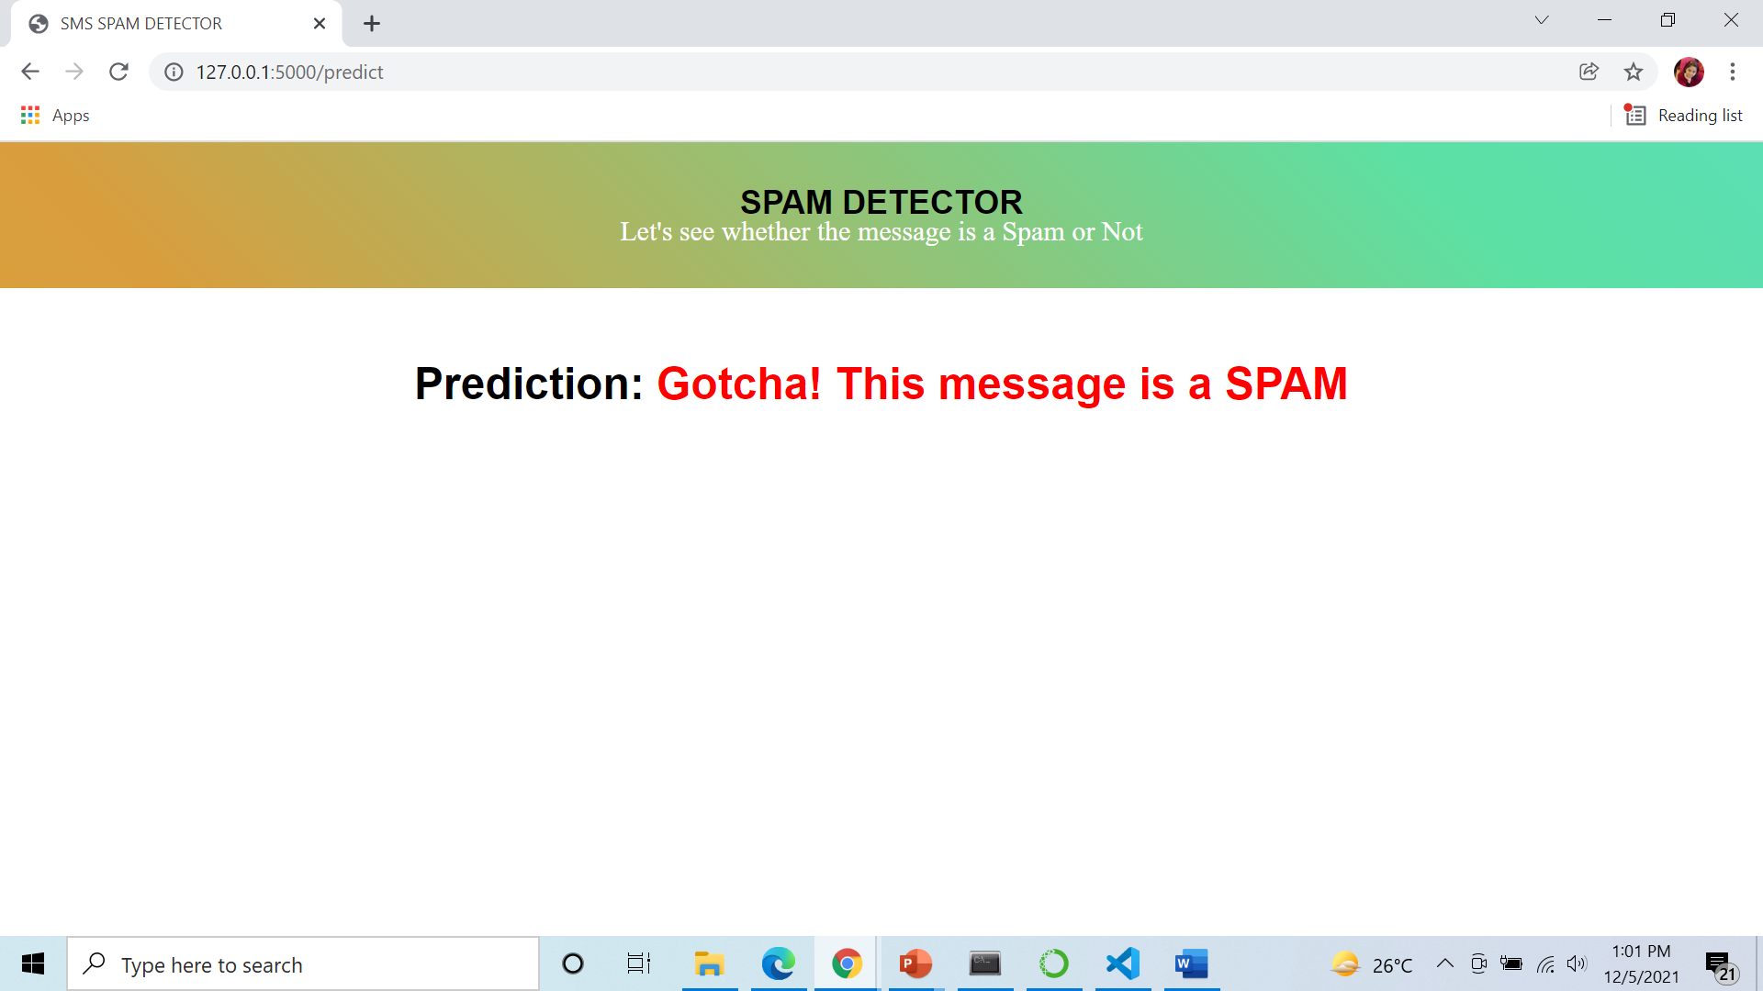

Results
Deployment Results from our Spam Filtering Model. The message has been taken from our dataset.

Slide 18
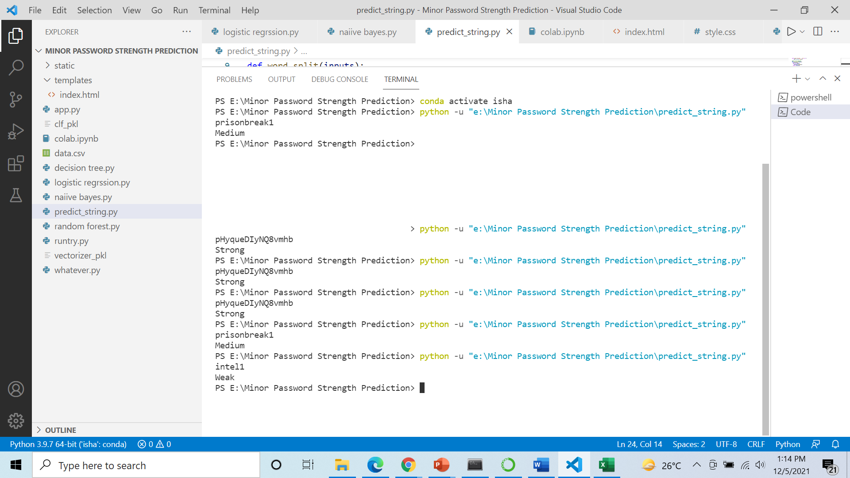
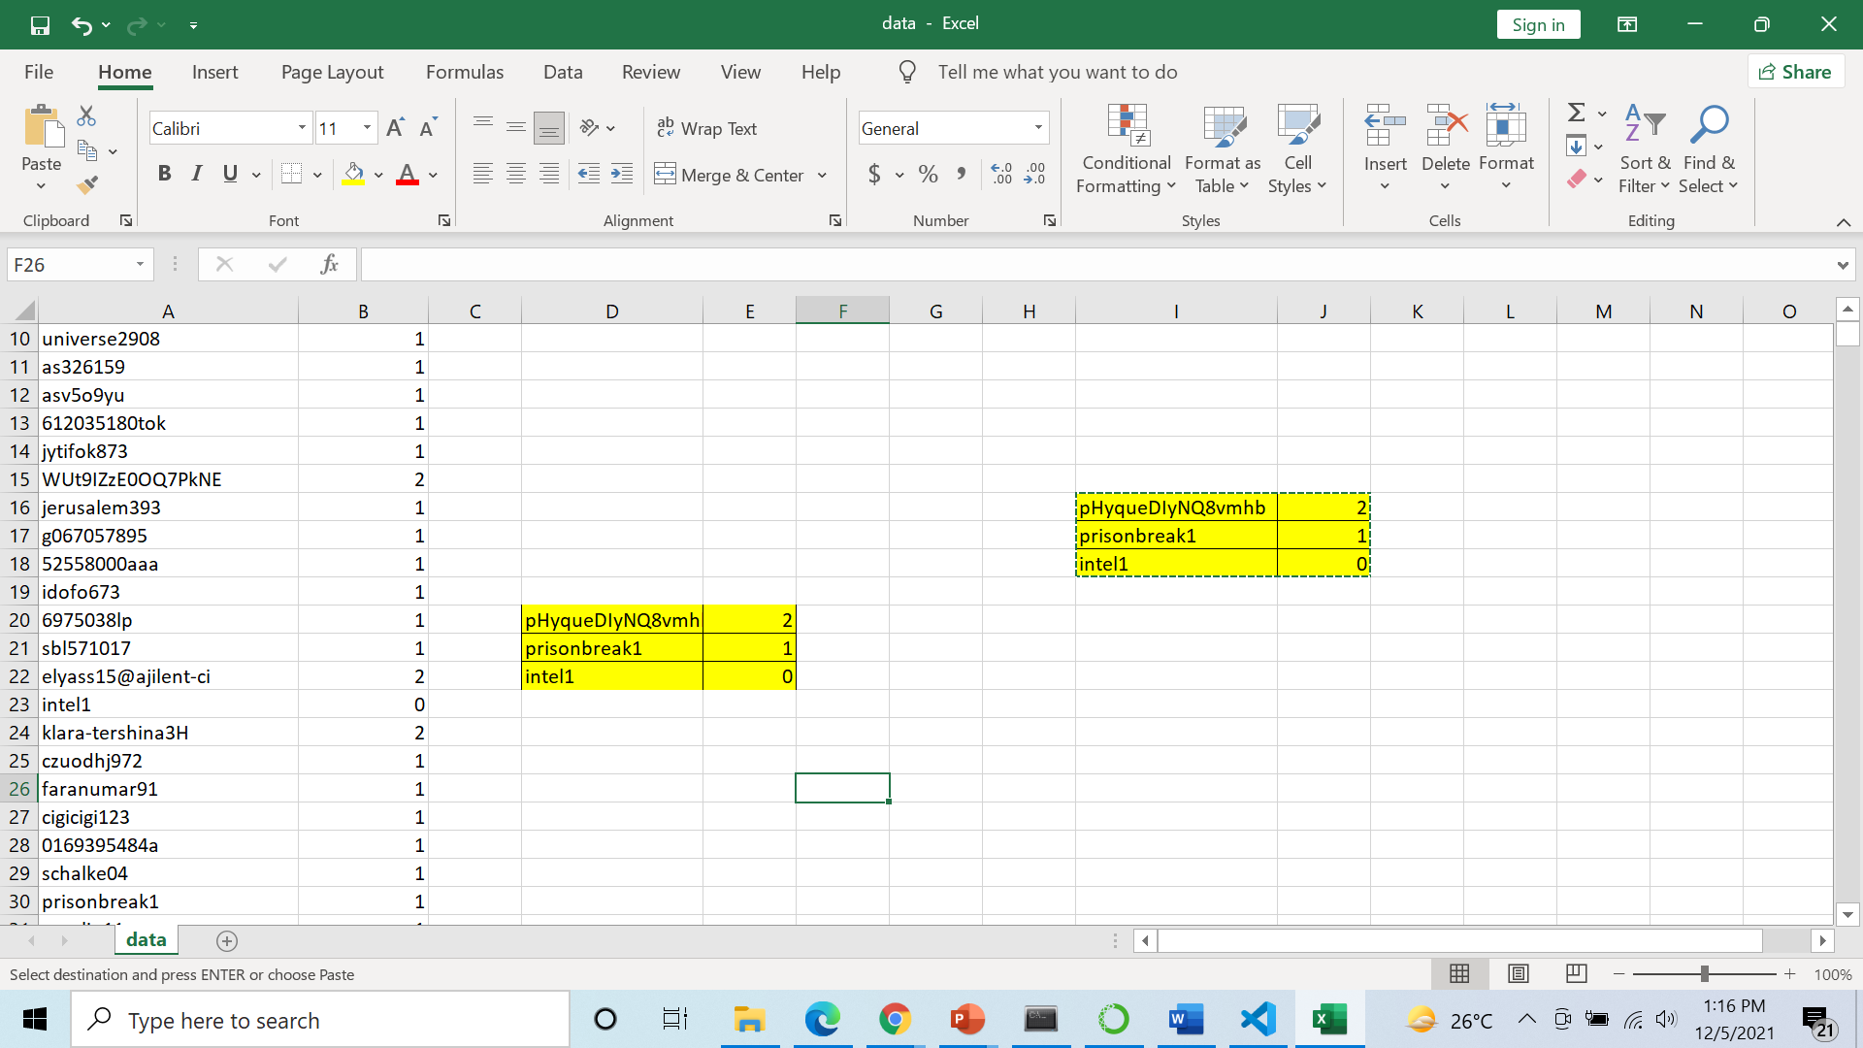
Password Strength Detection Results
3 passwords of varying strength taken from our dataset
Password Strength of the given passwords predicted accurately by our model

Slide 19

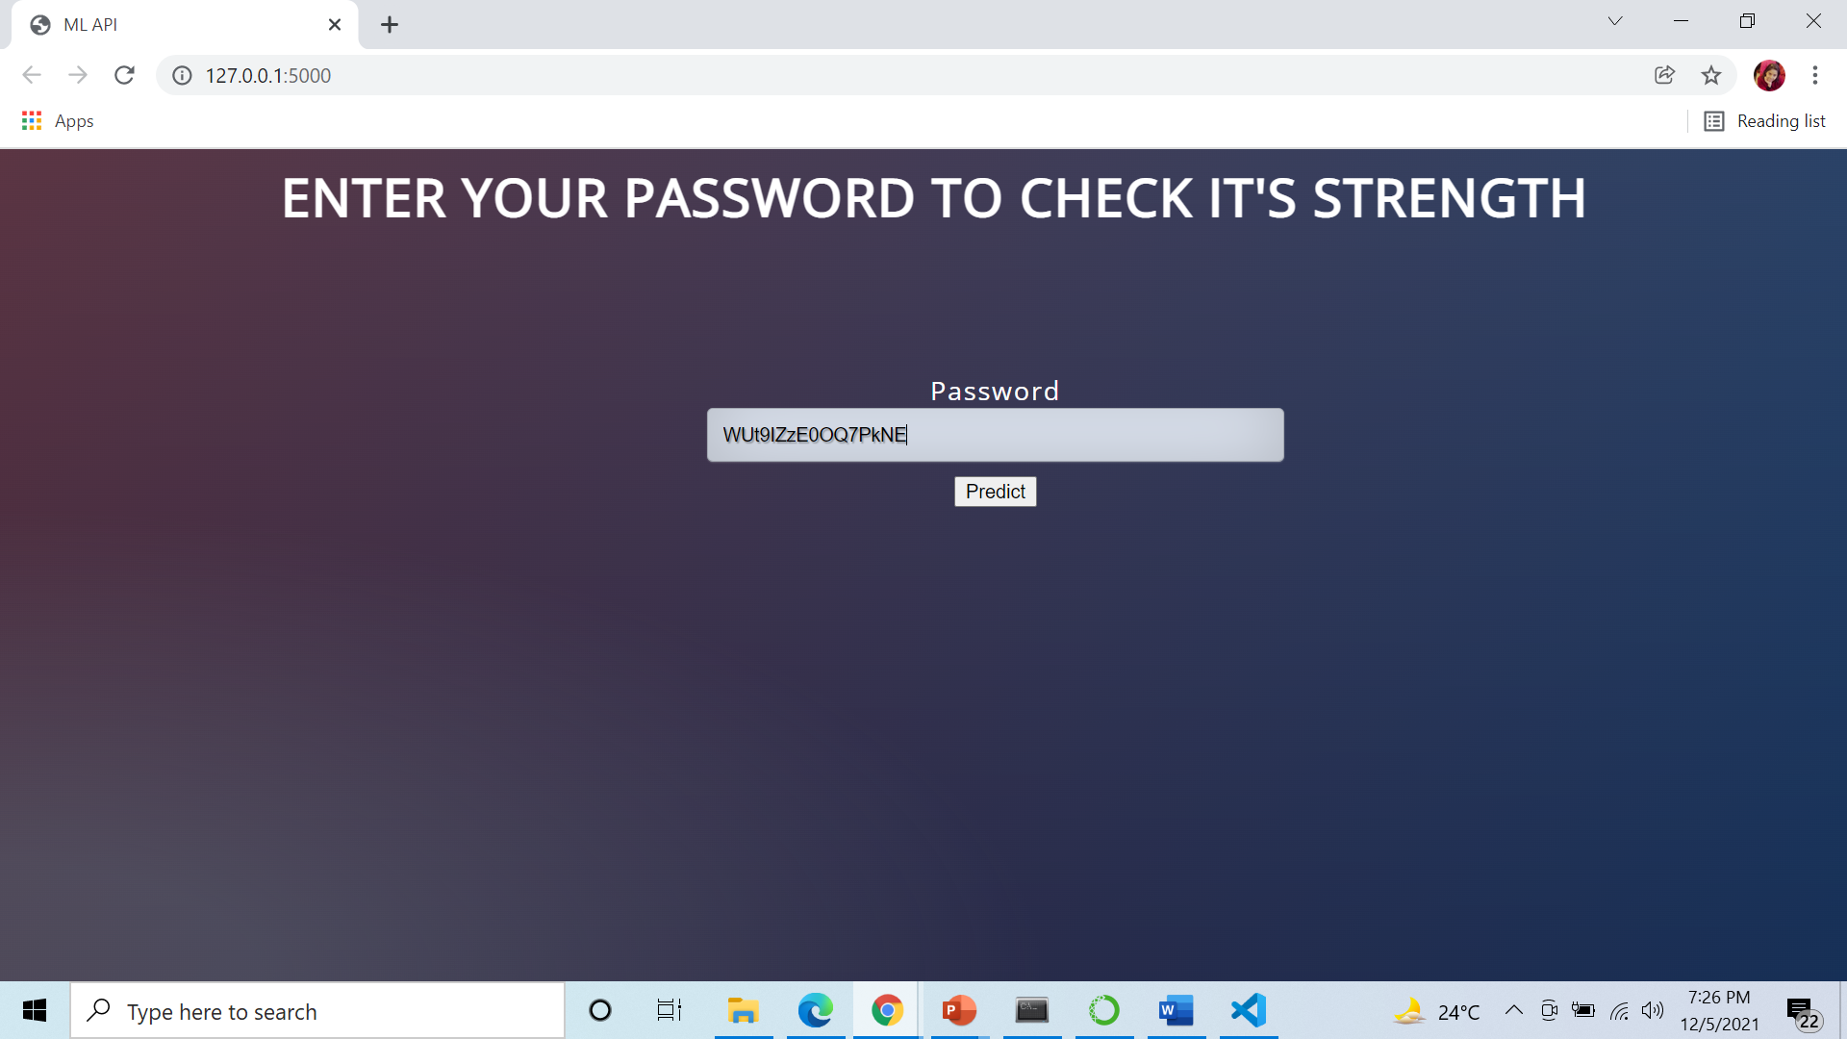
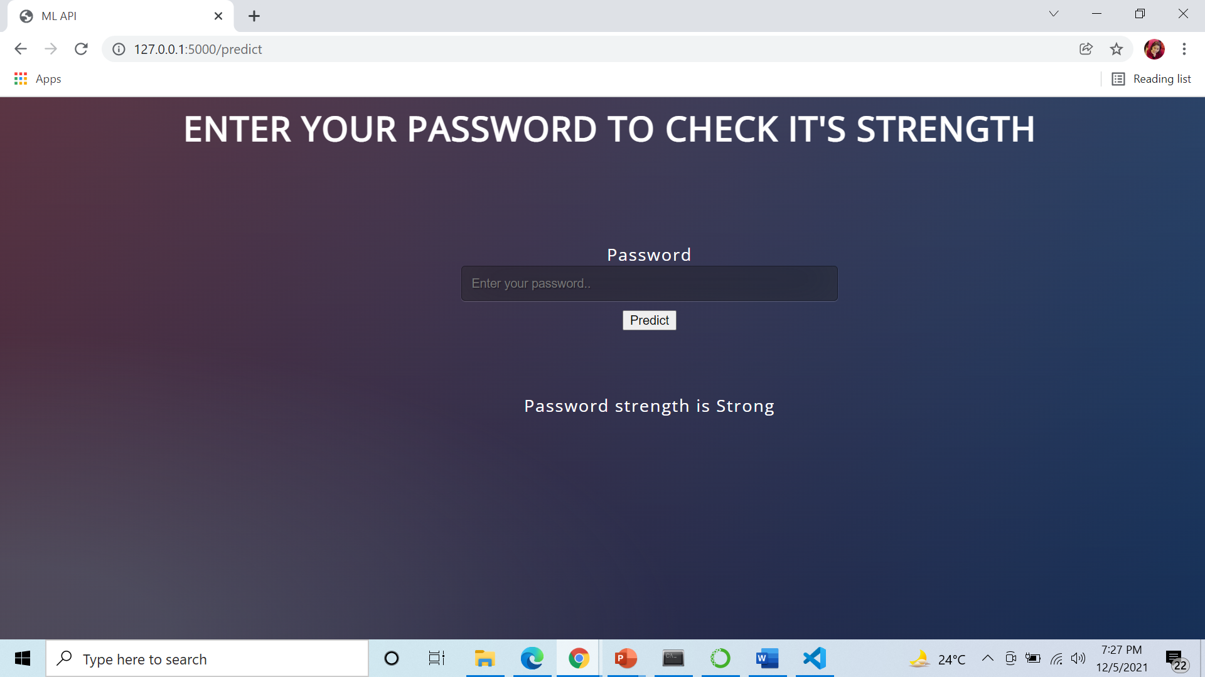
Password Strength Detection Deployment

Slide 20
NEED FOR MALWARE DETECTION IN URL
According to statistics the attacks by spreading malicious URL technique are ranked first among the 10 most common attack techniques.
From the statistics of the increase in the number of malicious URL distributions over the years, it is clear that there is a need to study and apply techniques or methods to detect and prevent these malicious URLs.

Slide 21
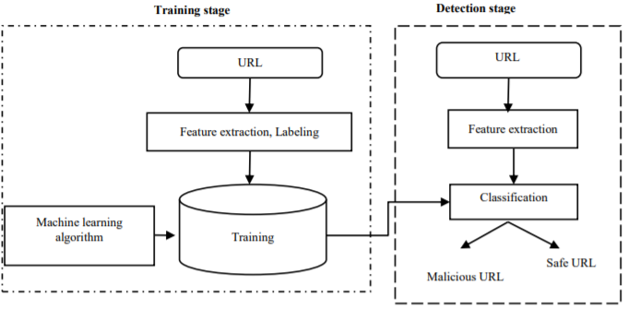
MALWARE DETECTION IN URL USING MACHINE LEARNING ARCHITECTURE
SOURCE :
https://pdfs.semanticscholar.org/2589/5814fe70d994f7d673b6a6e2cc49f7f8d3b9.pdf

Slide 22
PROBLEM 4: DETECTION OF MALWARE IN URL USING MACHINE LEARNING AND DEPLOYMENT ON A WEB SERVER
The primary objective is to create a Malware Detection System in URL and deploying it in our web application
Machine Learning is employed to create a system which can detect malicious URLs with high accuracy.
A web framework is created so as to integrate a machine learning model into an existing production environment where it can take in an input and return an output
The purpose of deploying a model is so as to make the predictions from a trained ML model available to others, whether that be users, management, or other systems.

Slide 23
IMPLEMENTATION
Logistic Regression acts as the driver algorithm for our model
The data is preprocessed using TFIDF vectorizer with tokenizer being a user defined function maketokens.
After the features are defined we split the data using scikit learn library in a ratio of 80:20 . With 80% data used for training and 20% data used for testing
From scikit learn library pipeline class is used to train the model.It encapsulates both Logistic regression and TFIDF vectorizer
After training our Model we evaluate it on testing data and then on new data to calibrate its accuracy

Slide 24
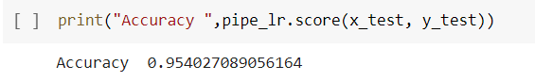
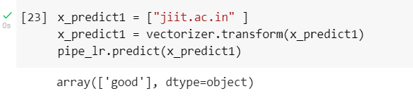
RESULTS
Accuracy of our Model
Predictions from Model
Source: Output of our source file
Results obtained by Implementation of ML model

Slide 25
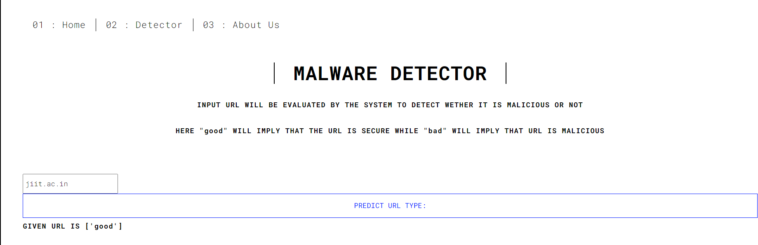
RESULTS
Predictions from our webpage
Source: Output of our web page
Deployment Result of our Model

Slide 26
LEARNING OUTCOMES
This project helped us in familiarizing us with the different aspects of Artificial Intelligence and the way they can be implemented to solve problems efficiently in the Cybersecurity branch.
It introduced us to the various statistical notions and enabled us to apply them in various real world problems.
It also helped us in articulating the differences between traditional programming methods and modern solutions based on Machine Learning Algorithms.

Slide 27
REFERENCES
[1] Peter Sugimura, Florian Hartl, “Building a Reproducible Machine Learning Pipeline”Sugimura, Peter and Florian Hartl. “Building a Reproducible Machine Learning Pipeline.” ArXiv abs/1810.04570 (2018): n. pag.Published 9 October.
[2] Shrawan Kumar Trivedi “A Study of Machine Learning Classifiers for Spam Detection”, 4th International Symposium on Computational and Business Intelligence, 2016.
[3] Michael Crawford, Taghi M. Khoshgoftaar, Joseph D. Prusa, Aaron N. Richter and Hamzah Al Najada “Survey of review spam detection using machine learning techniques “Journal of Big Data, 2015.
[4] Tishenko Victor Nikolaevich,Cho Do Xuan, Hoa Dinh Nguyen “Malicious URL Detection based on Machine Learning” International Journal of Advanced Computer Science and
Applications Vol. 11, No. 1, 2020
[5] N.Vanitha,V.Vinodni “Malicious-URL Detection using Logistic Regression Technique”International Journal of Engineering and
Management Research December 2019

Slide 28
THANK YOU
A special thanks to our mentor Dr. Jitendra Mohan for his constant guidance and valuable suggestions
Presented To:
Dr.Hemant Bhatt
Dr.Yogesh Kumar

